Slide 1
ACAT Monitoring & Evaluation Technical Assessment
Presented by: Luyanda Ngcamu
Last updated: 23 October 2025

Slide 2
Introduction
This presentation summarizes the analysis of beneficiary and program activity data from ACAT’s partner organizations. The focus is on understanding data quality, identifying participation trends, and suggesting practical improvements for better monitoring and evaluation.
ACAT’s current data is stored in multiple Excel spreadsheets with inconsistencies, missing values, and duplicates. These data quality issues make it difficult to track program performance and beneficiary engagement effectively.

Slide 3
Objective
To assess data quality, analyse participation patterns, and provide actionable recommendations that will strengthen ACAT’s data management and support accurate, efficient program monitoring.
Tools: Microsoft Excel and Power BI

Slide 4
Data Quality Findings
Combined fields
Missing data (e.g. id’s, contact numbers, missing responses, etc)
Inconsistent formats (e.g. gender, partner organization category)
Invalid IDs (length is greater or less than 13)
Duplicates (e.g. beneficiary_id’s)
Standardization applied (e.g. converting to uppercase and making entries consistent)
Missing categories (e.g. enrollment_month and date_of_exit)

Slide 5
Data Analysis

Slide 6
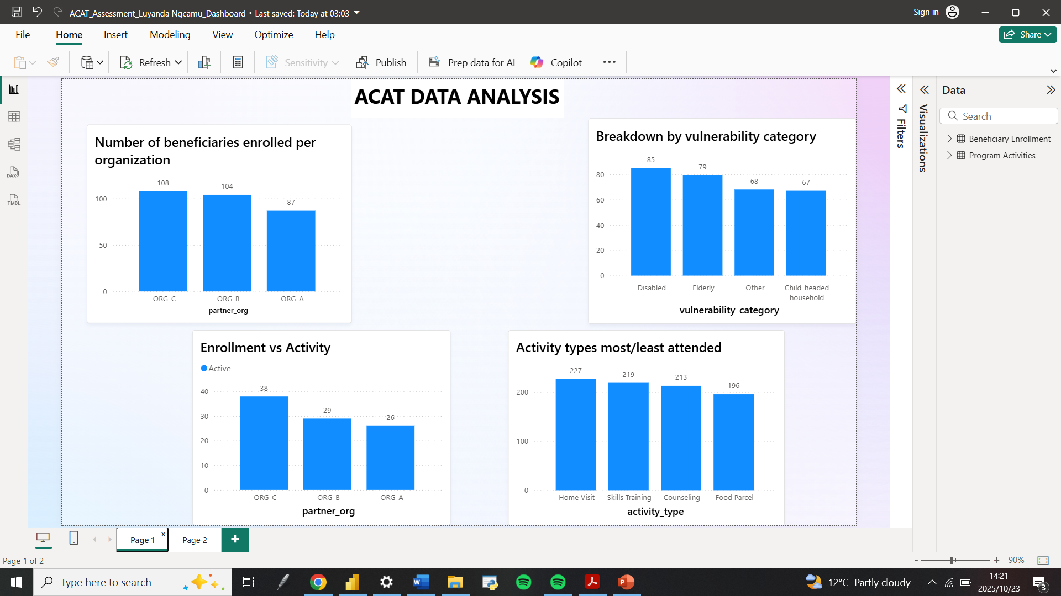

Slide 7
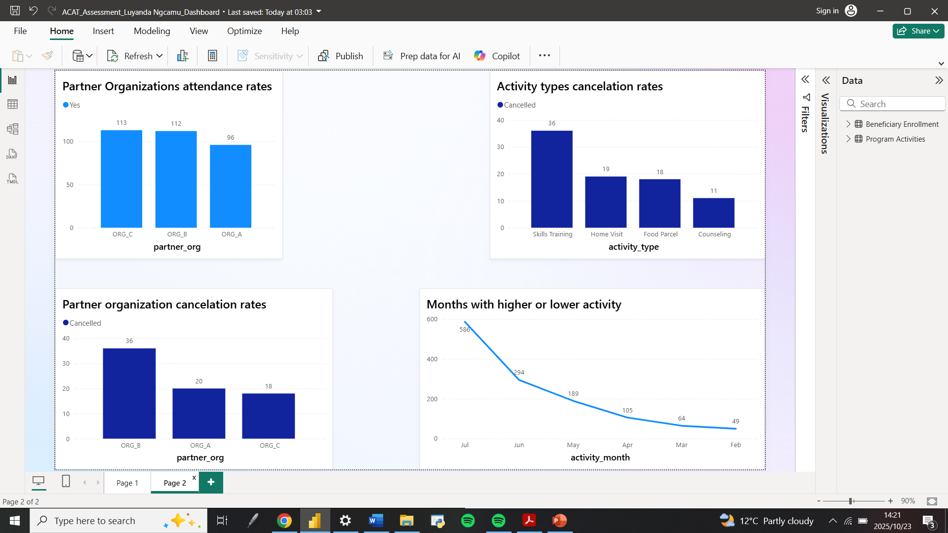

Slide 8
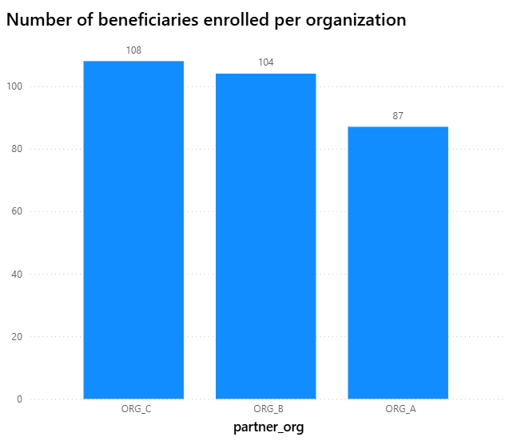
How many beneficiaries are enrolled per partner organisation?
ORG_C enrolled the highest number of beneficiaries which is108, followed closely by ORG_B with 104 and ORG_A with 87 beneficiaries.
The distribution of enrolment is relatively balanced, showing that all three partners are actively contributing to beneficiary intake.

Slide 9
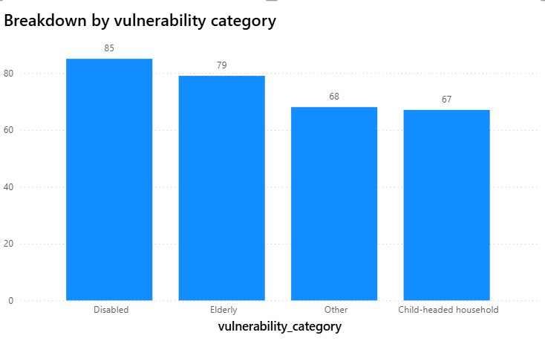
LL What is the breakdown by vulnerability category?
The largest group of beneficiaries is Disabled (85), followed by Elderly (79), Other (68), and Child-headed households (67).
This suggests that people with disabilities represent the most supported group, indicating a strong focus on inclusivity and accessibility within the program.

Slide 10
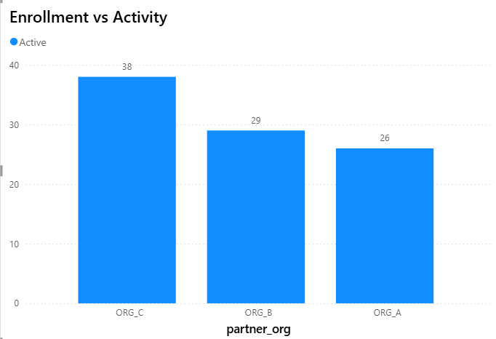
Are there patterns in who enrols vs. who stay active?
ORG_C has the highest number of active beneficiaries which is 38, followed by ORG_B with 29 active beneficiaries and ORG_A with 26 active beneficiaries, which is the lowest.
ORG_C leads in activity, showing higher engagement levels compared to ORG_B and ORG_A. Understanding the factors driving ORG_C’s stronger participation could help raise activity across all partners.

Slide 11
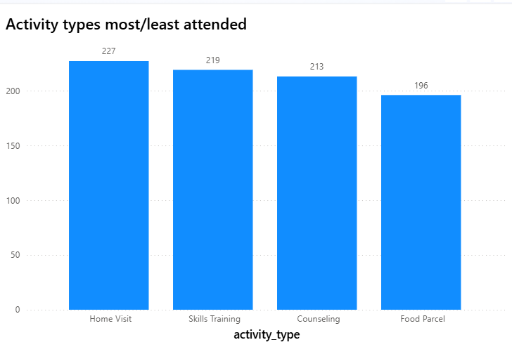
Which activity types are most/least attended?
Home Visits (227) and Skills training (219) are the most attended activities, followed by Counselling (213). Food Parcel(196) has the lowest attendance.
Beneficiaries appear more engaged in interactive or developmental activities such as home visits and skills training than in once-off support services like food distribution

Slide 12
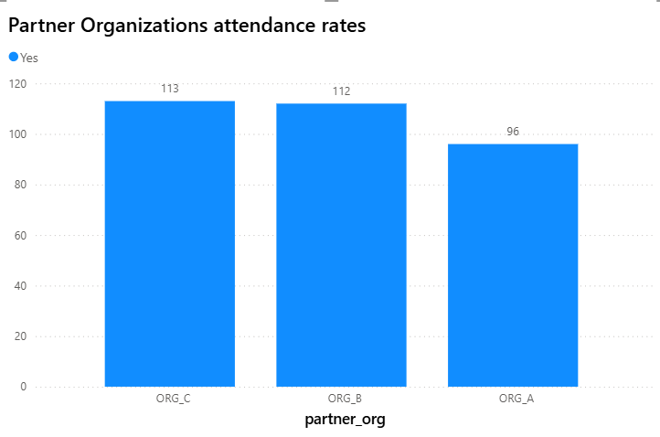
Which partner organization has the highest attendance rates?
ORG_C has the highest attendance rate of 113, followed by ORG_B with 112 and ORG_A with 96.
ORG_C and ORG_B leads in attendance, showing higher engagement levels compared to ORG_A. Understanding the factors driving ORG_C and B’s stronger participation could help raise attendance across all partners.

Slide 13
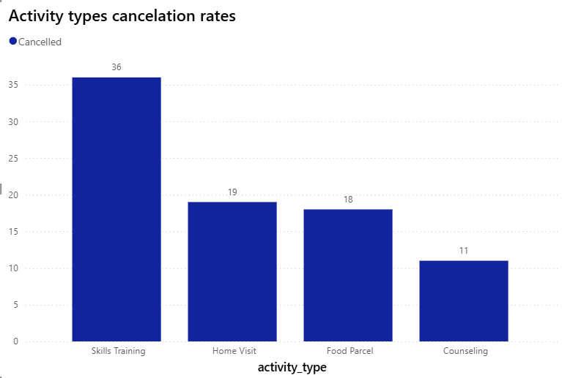
Are there any concerning patterns?
Skills Training has the highest number of cancellations (36), while Counselling has the lowest (11). Home Visits (19) and Food Parcels (18) fall in the mid-range.
This pattern implies that longer or more resource-intensive activities like Skills Training are more likely to be postponed or cancelled, possibly due to financial challenges, etc.

Slide 14
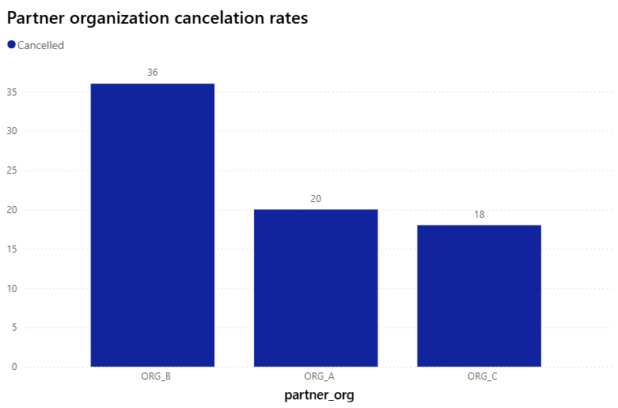
Are there any concerning patterns?
ORG_B (36) has the highest cancellation rate cancelled activities, followed by ORG_A (20) and ORG_C (18).
This suggests that ORG_B is facing scheduling, communication, and attendance challenges like financial challenges that are affecting program delivery.

Slide 15
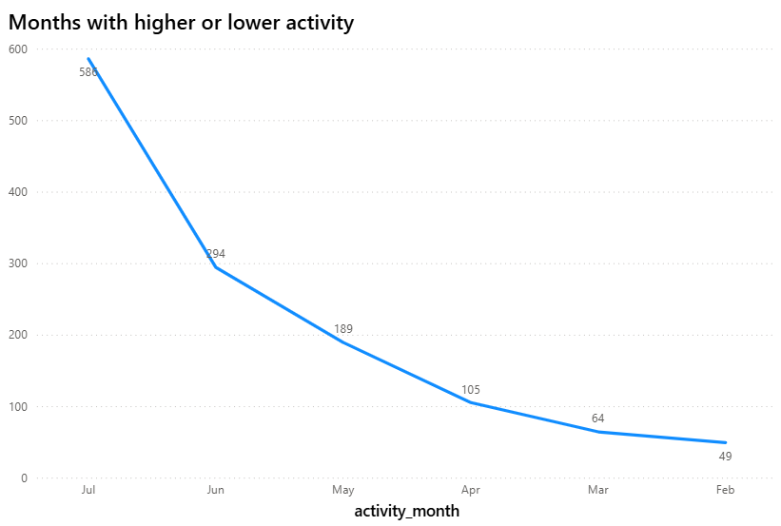
Are there certain months with higher/lower activity?
February(49), suggests that there’s minimal engagement or participation early in the year. As time progressed, there was a gradual and consistent increase : March (64) , April (105), May (189), reflecting stronger engagement or program momentum. June (294) and July(586) which is the highest peak.
Pattern tells a story of growth and momentum which could indicate that awareness or outreach efforts became more effective over time.

Slide 16
How long do beneficiaries typically stay in the program?
Ideally, the duration could be calculated by subtracting the enrolment date from a recorded completion or exit date. The dataset does not include a completion or exit date for beneficiaries, so it was not possible to calculate the exact duration that beneficiaries stay in the program. Therefore, the duration of participation cannot be determined from the current dataset.

Slide 17
Recommendations
Data Quality Issues: Inconsistent or incomplete ID numbers and contact details, Duplicate or mismatched beneficiary records across datasets and Inconsistent data entry for categorical fields (e.g., gender, activity type, attended)
Data Collection Improvements: Missing fields for monitoring, Simplify data entry and Validation rules.
Monitoring Dashboard Ideas: Enrolment vs Active Beneficiaries (Clustered Column Chart)Activity Attendance Rate by Type (Bar or Pie Chart) and Vulnerability Breakdown (Stacked Column or Donut Chart).
Key Monthly Metrics to Track:
Total beneficiaries enrolled and active.
Attendance rate (%) across all activities.
Number of new enrolments vs exits per month.
Activities delivered by partner organization.
Percentage of incomplete or missing data fields (data quality indicator).

Slide 18
Conclusion
The analysis highlighted both data quality gaps and key program insights. Despite initial issues such as missing values, inconsistent formats, and invalid IDs, data cleaning improved overall accuracy and usability. Program analysis showed that ORG_C leads in both enrolment and activity participation, while Disabled and Elderly beneficiaries form the largest groups served. Home Visits and Skills Training were the most attended activities, and participation increased steadily from February to July, indicating growing engagement. To sustain data reliability, continuous validation, standardized entry formats, and improved monitoring processes are essential for accurate tracking and effective program evaluation.

Slide 19

Thank you!!!

